Slide 1
ECLI in the Netherlands: Comply or Explain
Marc van Opijnen
Publications Office of the Netherlands (UBR|KOOP)
ECLI Adviser to the Council for the Judiciary
Conference ECLI and Beyond: Improving Online Access to Court Decisions
Athens, 8 June 2017
marc.opijnen@koop.overheid.nl

Slide 2
History
< 2001: Commercial identifiers and/or case numbers: quite messy
2001: ‘LJN’ (national case law identifier)
For all decisions in internal judiciary portal:
Public website
Internal database
(Most) commercial periodicals
2006: LJN-index online.

Slide 3
History
2013: LJN >> ECLI
Backwards compatible:
ECLI:NL:RBROT:2012:BW5386
ECLI:NL:RBROT:2016:3924
More internal decisions
More commercial periodicals
Register fully integrated with decision database
2014: Connected to ECLI search engine.

Slide 4
The Register
ECLI can be assigned to:
All decisions in public judiciary database
All decisions in internal judiciary database
All decisions published by every legal publisher, from whatever date
Publishers can register additional identifiers
Registration webservice is free of charge.

Slide 5
Metadata & Linked Data
Metadata & search important for transparency

Slide 6
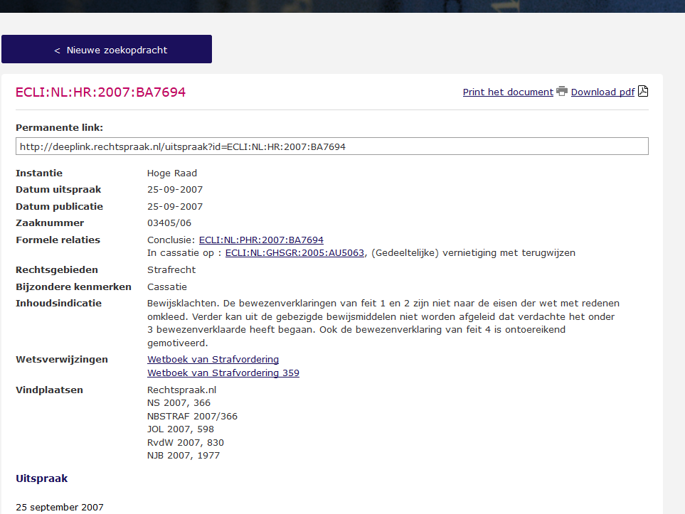

Slide 7
Metadata & Linked Data
2017: automated link detection for decisions, legislation, parliamentary documents
Implemented on Legal Linked Data website
In the document text
Search by link
Deep link from case law database.

Slide 8
Open Data
2004: all decisions in public database in XML via FTP
2007: LJN-index via SOAP webservice
2013: decisions and ECLI register RDF / REST service.

Slide 9
Standardisation
LJN / ECLI adopted by Juriconnect, a public/private standardisation platform for legal information
ECLI is the only reliable and omnipresent identifier
Prefered citation in the de facto legal citation guide
2013: ECLI replaced LJN on the comply or explain list of the Dutch IT Standardisation Board.

Slide 10
Coverage
ECLI:
Published on website 400.000
Internal: 2.500.000
Commercial: 200.000
Will be assigned to all decisions
Will be printed on authentic decision.

Slide 11
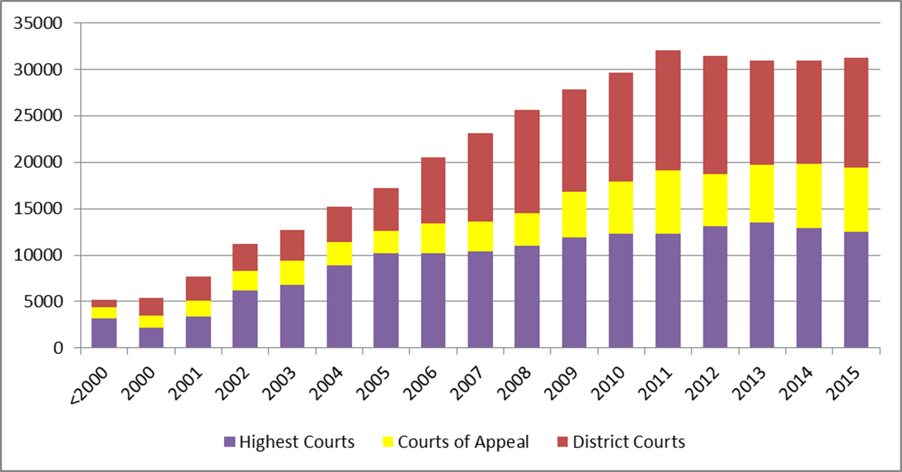
Publication Statistics

Slide 12
Thank you for your attention
This project is co-funded by
the European Union
This presentation has been produced with the financial support of the Justice Programme of the European Union. The contents of this publication are the sole responsibility of the partners of the BO-ECLI project and can in no way be taken to reflect the views of the European Commission.

